Slide 1
Chomsky Normal Form
Faculty: Nabila Sabrin Sworna
CSE Department, UIU

Slide 2
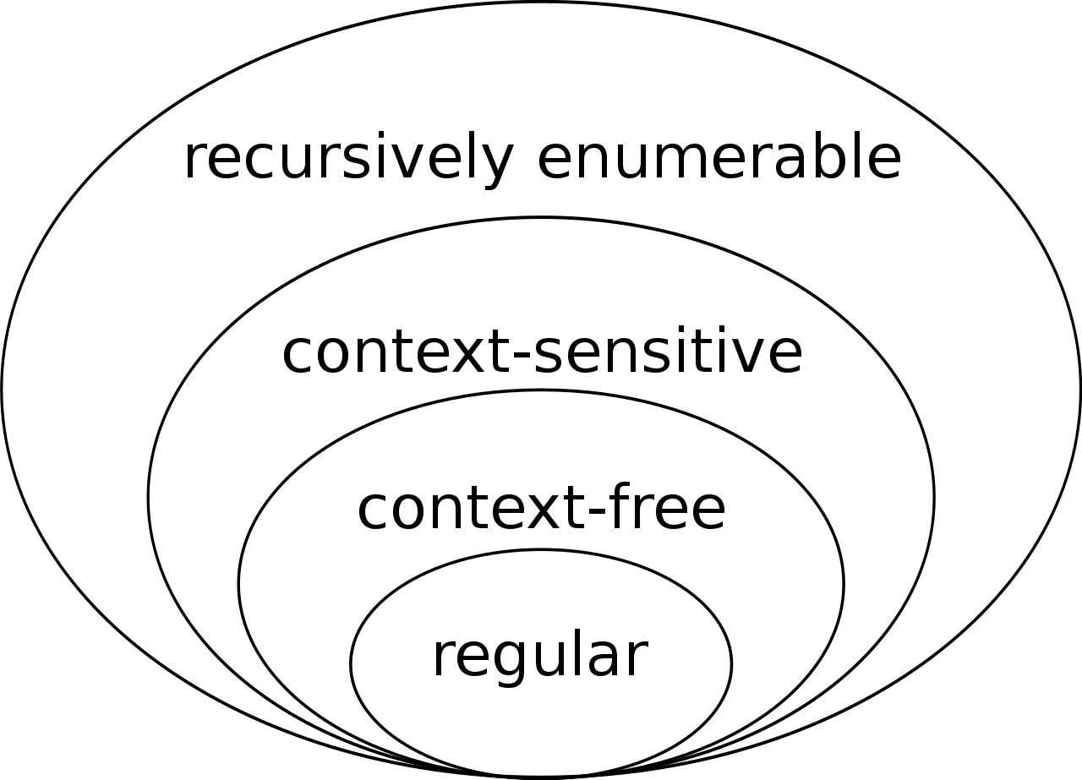
Language onion

Slide 3
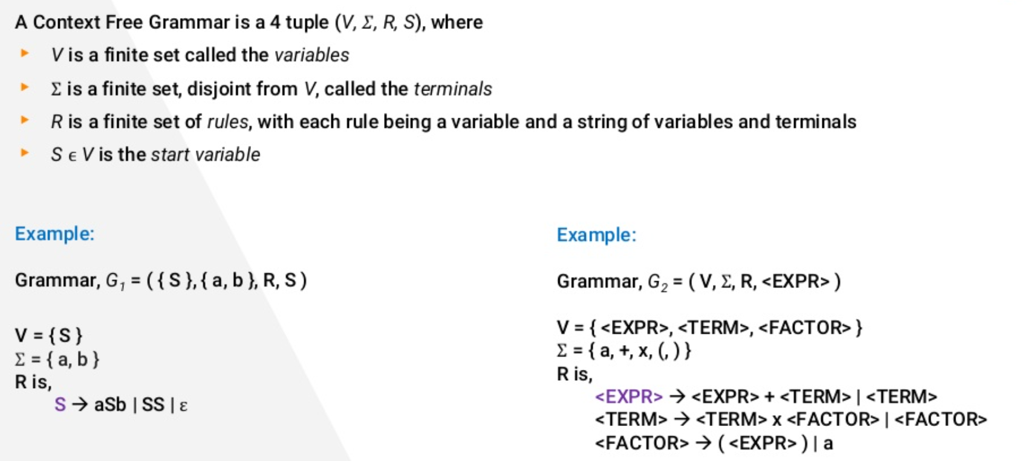
Context-free grammar

Slide 4
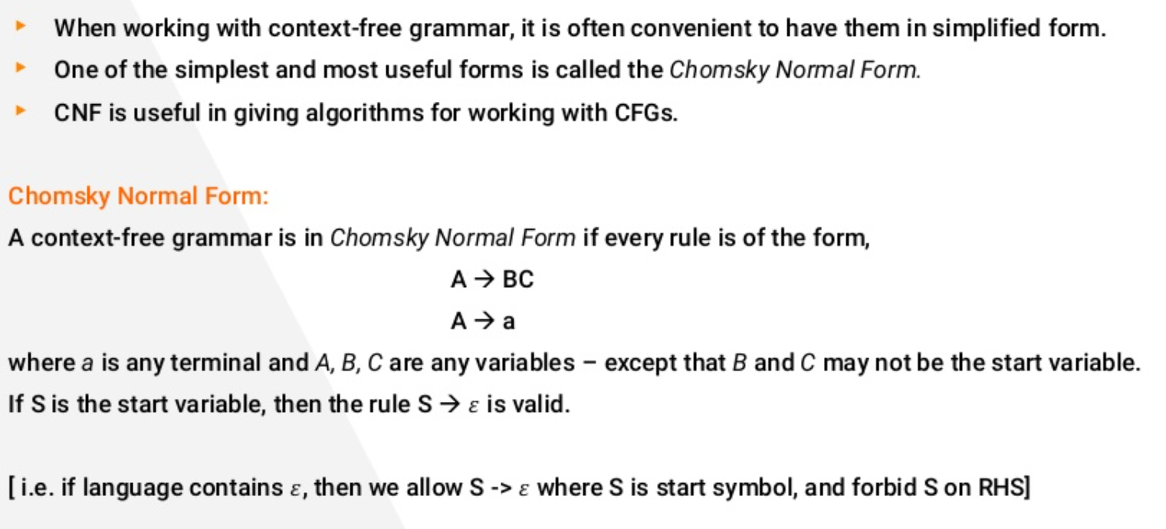

Slide 5
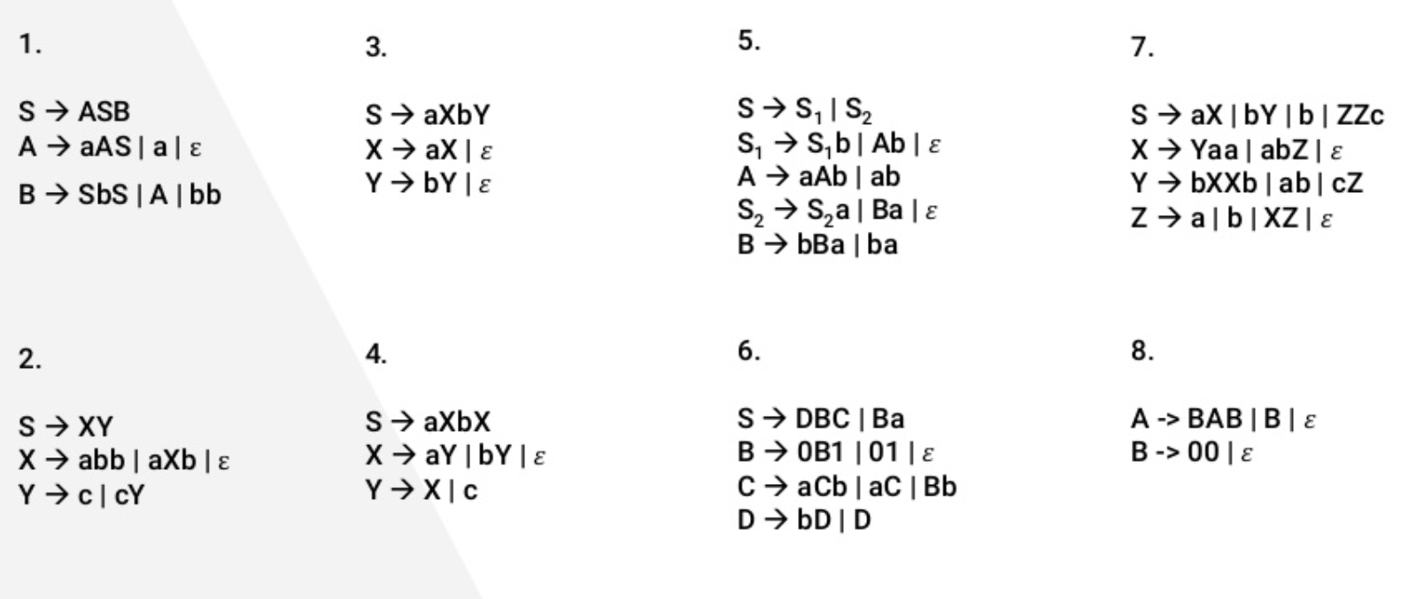
CFG to CNF Practice

